Slide 1
Lecture-1
Introduction to C

Slide 2
Programming Or Implementation Phase
Coding
Translation or conversion of each operation in the flowchart or algorithm (pseudocode) into a computer-understandable language.
Coding should follow the format of the chosen programming language.
Many types or levels of computer programming language such as:
Machine language
Symbolic language or assembly language
Procedure-oriented language
The first two languages are also called low-level programming language. While the last one is called high-level programming language.

Slide 3
Programming Or Implementation Phase
Machine Language
Machine language uses number to represent letters, alphabets or special character that are used to represent bit pattern.
Example:
an instruction to add regular pay to overtime pay, yielding total pay might be written in machine language as follows:
16 128 64 8
in which 16 is a code that mean ADD to the computer. The 128 and 64 are addresses or location at which regular pay and overtime pay are stored. The 8 represents the storage location for the total pay.

Slide 4
Programming Or Implementation Phase
Sometimes, bit pattern that represent letters and alphabets are used for coding.
Example:
Instead of: 16 128 64 8
Use: 10000 10000000 1000000 1000
This representation is ideal for a computer but difficult and tedious to the programmer to write a lengthy program.

Slide 5
Programming Or Implementation Phase
Symbolic Language or Assembly Language
A symbolic language or assembly language is closely related to machine language in that, one symbolic instruction will translate into one machine-language instruction.
Contain fewer symbols, and these symbols may be letters and special characters, as well as numbers.
As example, a machine language instruction
16 128 64 8
can be rewritten in assembly language as
ADD LOC1 LOC2 LOC3
Which means, add content of location LOC1 to location LOC2 and put the result in location LOC3.

Slide 6
Programming Or Implementation Phase
Procedure – Oriented Language
Programmer has to know the computer hardware before he can write program in machine and assembly language. It means the language is machine dependent.
Using procedure – oriented language, the programmer can run the program in any computer hardware.
A special program called a compiler will translate program written using procedure – oriented language to machine language.

Slide 7
Programming Or Implementation Phase
Some example of the language:
COBOL (COmmon Business Oriented Language)
FORTRAN (FORmula TRANslation)
Pascal
C
C++
BASIC, etc.
These languages are also called high-level programming language

Slide 8
Programming Or Implementation Phase
Computer Language | Instruction Format
Machine language Assembly language BASIC FORTRAN COBOL Pascal C | 16 128 64 8 ADD LOC1 LOC2 LOC3 LET T = R + 0 TOTAL = RPAY + OPAY ADD RPAY, OPAY GIVING TOTAL TOTAL : = RPAY + OPAY TOTAL = RPAY + OPAY

Slide 9
Programming Or Implementation Phase
Compiling and Debugging
Compiling is a process of a compiler translates a program written in a particular high–level programming language into a form that the computer can execute.
The compiler will check the program code know also as source code so that any part of the source code that does not follow the format or any other language requirements will be flagged as syntax error.
This syntax error in also called bug, when error is found the programmer will debug or correct the error and then recompile the source code again.
The debugging process is continued until there is no more error in the program.

Slide 10
Programming Or Implementation Phase
Testing
The program code that contains no more error is called executable program. It is ready to be tested.
When it is tested, the data is given and the result is verified so that it should produced output as intended.
Though the program is error free, sometimes it does not produced the right result. In this case the program faces logic error.
Incorrect sequence of instruction is an example that causes logic error.

Slide 11
Programming Or Implementation Phase
Documentation and Maintenance
When the program is thoroughly tested for a substantial period of time and it is consistently producing the right output, it can be documented.
Documentation is important for future reference. Other programmer may take over the operation of the program and the best way to understand a program is by studying the documentation.
Trying to understand the logic of the program by looking at the source code is not a good approach.
Studying the documentation is necessary when the program is subjected to enhancement or modification.
Documentation is also necessary for management use as well as audit purposes.

Slide 12
The Modules and The Functions
The programmer breaks the problem into modules, each with specific function.
It is much easier to write and test many small modules than a single large program.
Modules are arranged according to processing order in interactivity chart.

Slide 13
The rules for designing modules
Each module is an entity and has one entrance and one exit.
Each module has a single function such as printing, calculating or entering data.
Each module is short enough to be easily read and modified.
The length of module governed by its function and the number of instruction to be executed.
A module is developed to control the order of processing.

Slide 14
Types of modules
Control module
Show the overall flow of data through the program. All other modules are subordinate to it.
Init module
Also called the preparation module, process instruction that are executed only once – at the beginning.
Process Data module
May be processed only once, or may be part of a loop.
Calculation Modules
Do arithmetic calculations.

Slide 15
Types of modules
Print Modules
Print output lines.
Read and Data validation modules
Read or input data, validate data
Validation modules separate from read modules
Wrap-up module
Execute only once at the end.
Include closing file and printing totals.
Event module
Such as mouse down, mouse up, key entry.

Slide 16
Local and Global Variables
The concept of local and global variables to allow cohesion and coupling to occur.
Local variables
defined within a module
used only by the module itself
Global variables
defined outside of the individual modules
can be used by all modules

Slide 17
Scope of Local and Global Variables
Variables: A, B, C
Global to all modules
CONTROL MODULE
Variables: X, Y, Z
Local to CONTROL MODULE
MODULE1
Variables: D, E, F
Local to MODULE1
MODULE2
Variables: G, H, I
Local to MODULE2

Slide 18
Parameters
Parameters are local variables that are passed or sent from one module to another.
Parameters are another way of facilitating coupling that allows the communication of data between modules.
Eg: Read(A, B, C) – A, B & C are parameters
There are two types of parameters:
Actual Parameter
list of parameters that follow the module name being processed in the calling module
Formal Parameter
list of parameters that follow the module name at the beginning of the module.

Slide 19
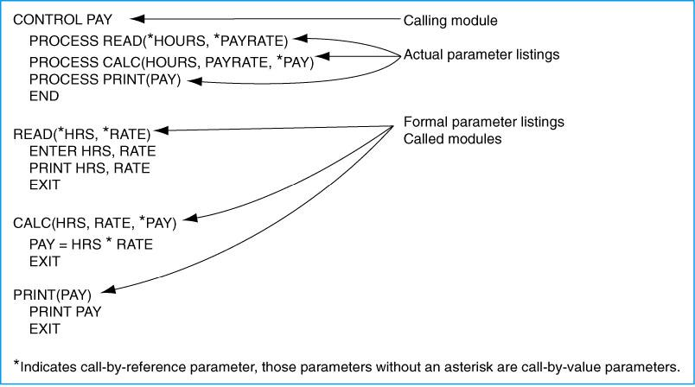
Parameter Terminology

Slide 20
Beginning Problem-Solving Concepts for the Computer
Data used in processing
Constant is a value that never changes during the processing of all instructions in a solution
Constant is given a location in memory and a name.
The value of a variable may change during processing

Slide 21
Rules for naming and using variables:
Name according to what it represented
Do not use spaces in a variable name
Do not a dash
Consistent in the use of variable names
Consistent when using upper and lowercase characters

Slide 22
Data Types
Data are unorganized facts
Goes as input and is processed to produce output, information
Computers must be told the data type of each variable and constant
3 common types: numeric, character, and logical
Other data types: date data type and user-defined data types

Slide 23
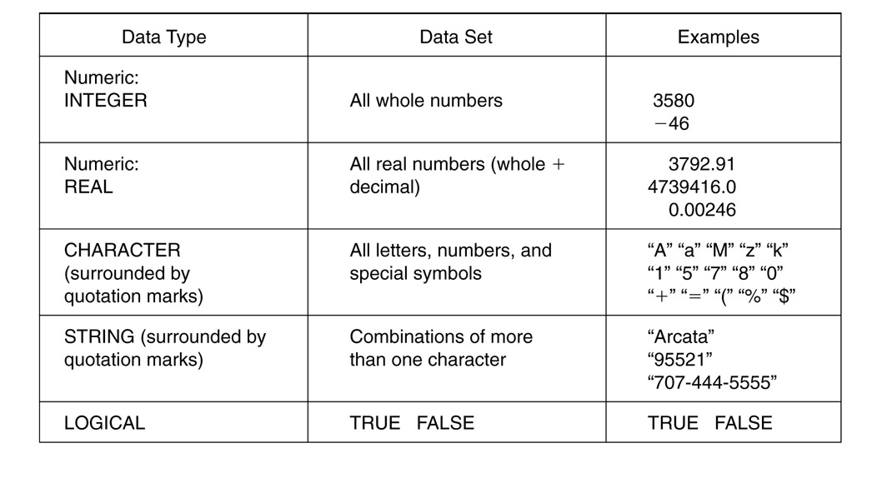

Slide 24
Rules of Data Types
Programmer designates the data type during the programming process
Data types cannot be mixed
Each data types used data set
Calculations involved only numeric data type.

Slide 25
Functions
Small sets of instructions that perform specific task and return values
Used as part of instruction in a solution
Divided into classes:
Mathematical functions – used in science and business
String functions – used to manipulate string variables
Conversion functions – used to convert data from one data type to another
Statistical functions – used to calculate things such as maximum value
Utility functions – access information outside the program, i.e. date and time function
Functions use data, called parameters. Functions normally do not alter parameters
Functionname(parameters list)

Slide 26
Operators
They are data connectors within expressions and equations.
They tell computer how to process the data
Operands are data the operator connects and processes
Resultant is the answer
Data type of the operand and the resultant depends on the operator:
Mathematical operators
Relational operators
Logical operators
Operators have a hierarchy or precedence

Slide 27
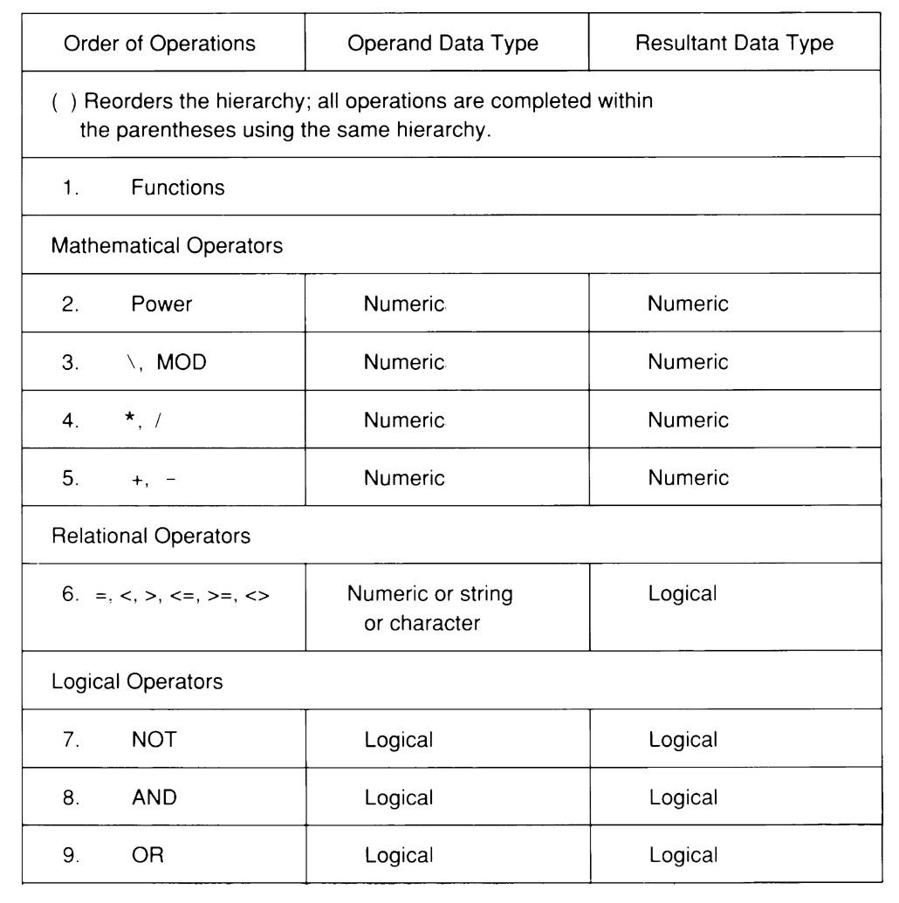

Slide 28
Expressions and Equations
Expression processes data, the operands, through the use of operators
Equation stores the resultant of an expression in a memory location in the computer through the equal (=) sign.
Equations are often called assignment statements

Slide 29
We’ll Learn Today:
History of C
Characteristics of C
Writing C Programs
Compilation
Anatomy of C Program
Variables

Slide 30
History of C
The milestones in C's development as a language are listed below:
C evolved from two previous languages, BCPL and B.
BCPL was developed as a language for writing operating-systems software and compilers.
Ken Thompson modeled many features in his B language after their counterparts in BCPL, and in 1970 he used B to create early versions of the UNIX operating system
In 1970 B was used to create early versions of the UNIX operating system

Slide 31
Characteristics of C
Small size
Extensive use of function calls
Loose typing -- unlike PASCAL
Structured language
Low level (BitWise) programming readily available
Pointer implementation - extensive use of pointers for memory, array, structures and functions.

Slide 32
C has now become a widely used professional language for various reasons.
It has high-level constructs.
It can handle low-level activities.
It produces efficient programs.
It can be compiled on a variety of computers.

Slide 33
Writing C Program
A programmer uses a text editor to create or modify files containing C code.
Code is also known as source code.
A file containing source code is called a source file.
After a C source file has been created, the programmer must invoke the C compiler before the program can be executed (run).

Slide 34
3 Stages of Compilation
Stage 1: Preprocessing
Performed by a program called the preprocessor
Modifies the source code (in RAM) according to preprocessor directives (preprocessor commands) embedded in the source code
skips comments and white space from the code
The source code as stored on disk is not modified.

Slide 35
3 Stages of Compilation (con’t)
Stage 2: Compilation
Performed by a program called the compiler
Translates the preprocessor-modified source code into object code (machine code)
Checks for syntax errors and warnings
Saves the object code to a disk file, if instructed to do so (we will not do this).
If any compiler errors are received, no object code file will be generated.
An object code file will be generated if only warnings, not errors, are received.

Slide 36
3 Stages of Compilation (con’t)
Stage 3: Linking
Combines the program object code with other object code to produce the executable file.
The other object code can come from the Run-Time Library, other libraries, or object files that you have created.
Saves the executable code to a disk file.
If any linker errors are received, no executable file will be generated.

Slide 37
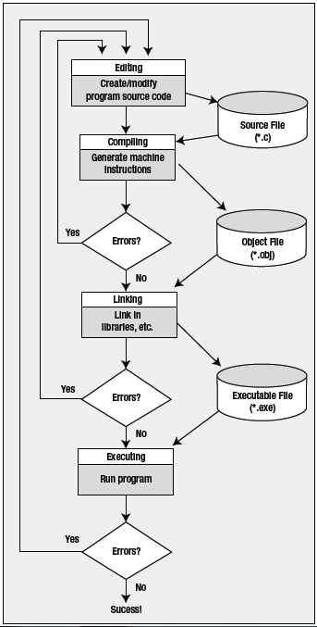
Architectural Diagram

Slide 38
A Simple C Program
/* Filename: First.c
Author: FAST
Date written: ?/?/2018
Description: This program prints the greeting “Hello, World!”
*/
#include <stdio.h>
void main ( void )
{
printf ( “This is class CS118!\n” ) ;
getch( ) ;
}

Slide 39
Running gcc’s manually
Preprocessing: adding stdio.h contents
gcc –E frist.c
Compilation: Converting into assemble code
gcc –S first.c
Assembling: assembly code to machine code
gcc –c first.s
hexdump first.o
Linking: linking with library files & producing .exe file
gcc –o myfirst first.o

Slide 40
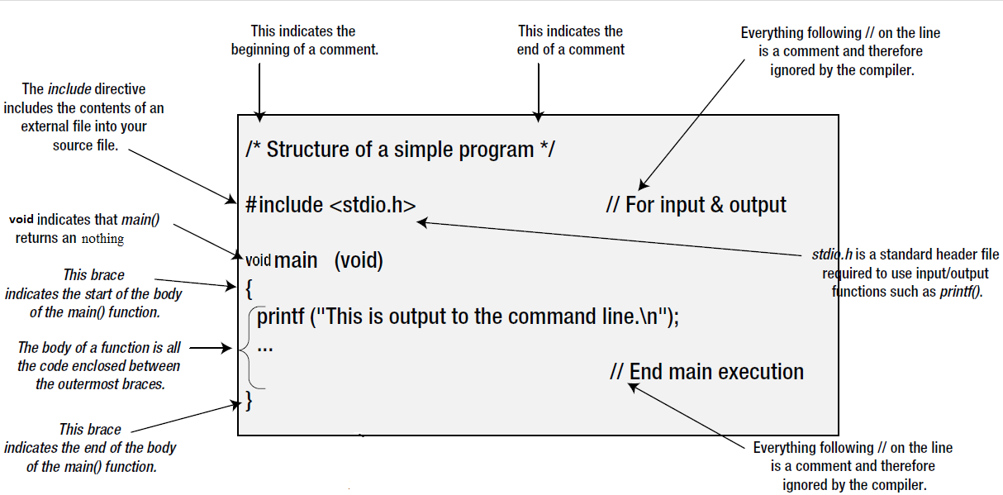
Anatomy of a C Program

Slide 41
Program Header Comment
A comment is descriptive text used to help a reader of the program understand its content.
All comments must begin with the characters /* and end with the characters */
These are called comment delimiters
The program header comment always comes first.

Slide 42
Preprocessor Directives
Lines that begin with a # in column 1 are called preprocessor directives (commands).
Example: the #include <stdio.h> directive causes the preprocessor to include a copy of the standard input/output header file stdio.h at this point in the code.
This header file was included because it contains information about the printf ( ) function that is used in this program.

Slide 43
stdio.h
When we write our programs, there are libraries of functions to help us so that we do not have to write the same code over and over.
Some of the functions are very complex and long. Not having to write them ourselves make it easier and faster to write programs.
Using the functions will also make it easier to learn to program!

Slide 44
void main (void)
Every program must have a function called main. This is where program execution begins.
main() is placed in the source code file as the first function for readability.
The reserved word “void” indicates that main() returns nothing.
The parentheses following the reserved word “main” indicate that it is a function.
The reserved word “void” means nothing is there.

Slide 45
The Function Body
A left brace (curly bracket) -- { -- begins the body of every function. A corresponding right brace -- } -- ends the function body.
The style is to place these braces on separate lines in column 1 and to indent the entire function body 3 to 5 spaces.

Slide 46
printf (“Hello, World!\n”);
This line is a C statement.
It is a call to the function printf ( ) with a single argument (parameter), namely the string “Hello, World!\n”.
Even though a string may contain many characters, the string itself should be thought of as a single quantity.
Notice that this line ends with a semicolon. All statements in C end with a semicolon.

Slide 47
getch();
getch() is built-in function
By using this function at end of file, it holds your output screen until you press any character.

Slide 48
Variables
A variable is a space in the computer’s memory set aside for a certain kind of data and given a name for easy reference.
Variable are used so that the same space in memory can hold different values at different times.
All variables must be defined to specify their name and type and set aside storage.

Slide 49
Variables (con’t)
To declare a variable in C, do:
var_type list variables;
e.g. int i, j, k;
float x, y, z;
char ch;

Slide 50
Variables (con’t)
Variable Types:
Type | Memory (byte) | Range
char | 1 | -128 to 127
int | 2 | -32,768 to 32,767
long int | 4 | -2,147,483,648 to 2,147,483,647
float | 4 | 10⁻³⁸ to 10³⁸ 7 digits precisions
double | 8 | 10⁻³⁰⁸ to 10³⁰⁸ 7 digits precisions

Slide 51
End of Lecture
Any Question ????

